Slide 1
CS 4530 & CS 5500
Software Engineering
Lecture 12.2: Ethics in Software Engineering
© 2021, released under CC BY-SA

Slide 2
Learning Objectives for this Lesson
By the end of this lesson, you should be able to…
Explain several of the meanings of “the public interest”.
List some sources of ethical guidance for a software engineer.
List several things that a software engineer can do to try to behave in an ethical manner.

Slide 3
Professional Ethics
Professional standards
By 1675, standards established for: divinity, law, medicine
Professionals exercise specialist knowledge or skill - professional ethics governs how this knowledge should be governed
12th-century Byzantine manuscript of the Hippocratic Oath
Notes:
Before getting into ethics for software engineering, it’s useful to think about the origins of professional ethics. “Professionals” in this context generally refers to individuals who exercise some special knowledge that the public-at-large does not hold. When a professional provides services to a layperson, it is important for that layperson to be able to trust that they are not being taken advantage of. For example, the earliest instance of professional ethics is likely the hippocratic oath, which is rooted in doing no harm. Professional ethics standards exist for many different professions.

Slide 4
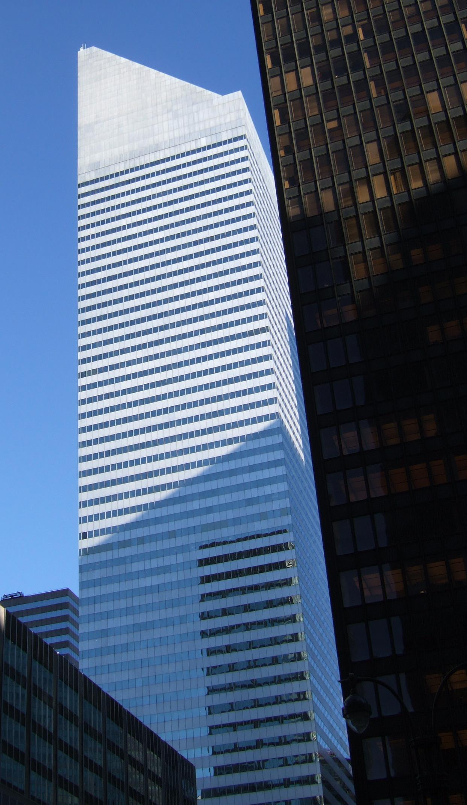
Code of Ethics
Professional Engineers
Engineers, in the fulfillment of their professional duties, shall:
Hold paramount the safety, health, and welfare of the public.
Perform services only in areas of their competence.
Issue public statements only in an objective and truthful manner.
Act for each employer or client as faithful agents or trustees.
Avoid deceptive acts.
Conduct themselves honorably, responsibly, ethically, and lawfully so as to enhance the honor, reputation, and usefulness of the profession.
National Society of Professional Engineers - Code of Ethics for Engineers
Notes:
Given that we’re talking about SOFTWARE engineering, it’s particularly useful to consider the closely related ethical problems that arise in civil engineering. Whereas it might be difficult to identify an immediate risk to life from a failure of most software, it is much easier to see how a miscalculation in the design of a building could result in the building to collapse, which would be catastrophic. Professional engineers are required to receive significant training in ethics to ensure that they understand the importance of, above all, ensuring the safety, health and welfare of the public. The building shown on this slide, the Citigroup tower in new york city, provides a particularly interesting case study of ethics in engineering.

Slide 5
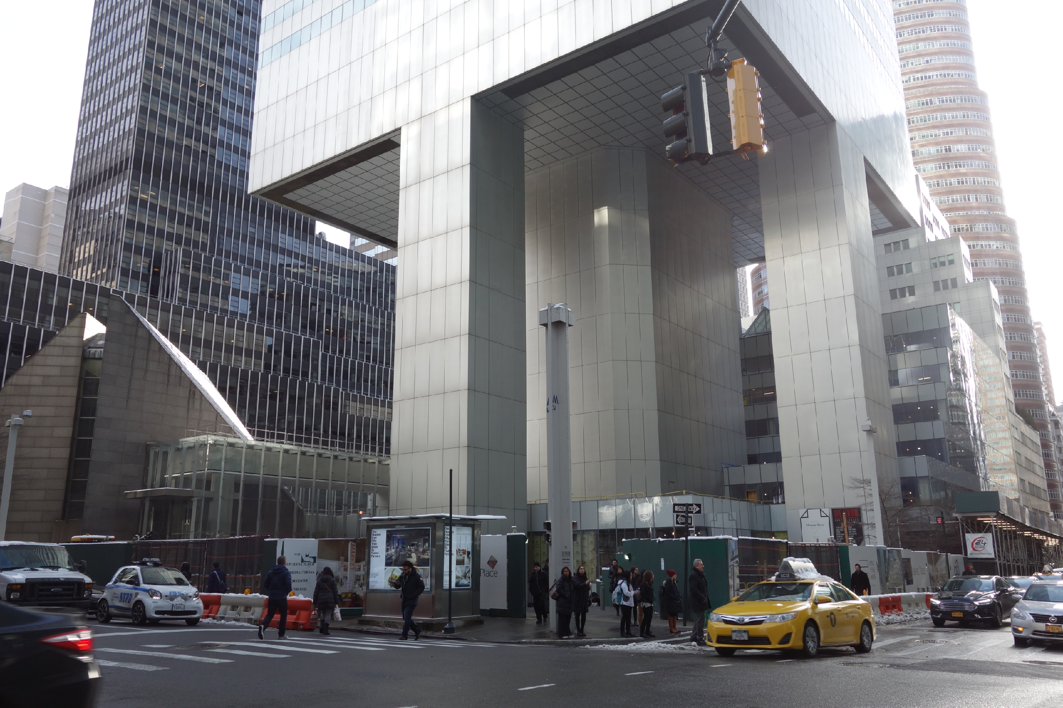
Code of Ethics
Professional Engineers: Citigroup Center
Design met building code, but did not account for all failure modes
Last-minute changes to construction increased odds of failure
Fixed before disaster could strike, but kept a secret for 20 years
https://www.theaiatrust.com/whitepapers/ethics/study.php
“Citigroup Center” by Tdorante10, Wikimedia commons, CC BY-SA 4.0
Notes:
Here’s a photo of the bottom of Citigroup Center, which was built 1974. It’s a very interesting building design: a 59 story tower cantilevered over a church - note this unique column architecture supporting the building. The engineer, LeMessurier, created a design that met building code (which in particular, required the design to be resilient to winds from N/S/E/W), but an analysis by an undergrad’s senior thesis found a diagonal hurricane-force wind would quite likely blow over the building. Usually face-on winds are the worst (for a building with columns on corners), but this building had columns in middle! Would have been OK if bottom joints were welded, but steel contractor wanted to bolt them to save millions of dollars, and was OKed. Fixed by the engineering firm, quite quickly, but also quietly. While being fixed added extra precautions to ensure safety and monitor weather, with evacuation plans. Kept secret for 20 years! This is a very interesting case study: note that the engineer did follow regulations, but still did not ensure safety in their design. Thankfully, the flaw was found by the student, and the engineering firm quickly took action to repair it, taking responsibility for the problem. One interesting discussion point here, however, is regarding how it was repaired - in secret! Do you think that this design flaw should have been made immediately public?

Slide 6
Badly-engineered software can kill people
Therac-25 (1985-1987)
Bug in software caused 100x greater exposure to radiation than intended
At least 6 died
Likely far more suffered: deaths occurred over a period of 2 years!
Weak accountability in manufacturer’s organization
“Therac-25” by Catalina Márquez, Wikimedia commons, CC BY-SA 4.0
https://ethicsunwrapped.utexas.edu/case-study/therac-25
Notes:
In contrast to the Citigroup tower case, where the engineering firm took responsibility for the failure and rectified it, let’s consider another classic professional ethics case, this one, from software engineering. A bug in the software controlling the THERAC-25 radiation treatment machine resulted in the death of at least 6 patients, and administered countless additional overdoses. Investigations after-the-fact found that the manufacturer had extremely poor software development and quality assurance processes, without independent code review, without testing, and without safety checks. The machine operators were assured that overdoses were impossible - software was reused from older machines which had hardware interlocks to prevent these software defects from being catastrophic. Note that one result of this incident is stronger standards for safety-critical (in particular: medical) software, which now require rigorous quality assurance practices. The manufacturer of the machine, however, could have easily prevented further damage had they immediately detected and resolved the bug after the first reported incident in 1985.

Slide 7
Code of Ethics
ACM’s Code of Ethics Software Engineers
1. PUBLIC – Software engineers shall act consistently with the public interest.
2. CLIENT AND EMPLOYER – Software engineers shall act in a manner that is in the best interests of their client and employer consistent with the public interest.
3. PRODUCT – Software engineers shall ensure that their products and related modifications meet the highest professional standards possible.
4. JUDGMENT – Software engineers shall maintain integrity and independence in their professional judgment.
5. MANAGEMENT – Software engineering managers and leaders shall subscribe to and promote an ethical approach to the management of software development and maintenance.
6. PROFESSION – Software engineers shall advance the integrity and reputation of the profession consistent with the public interest.
7. COLLEAGUES – Software engineers shall be fair to and supportive of their colleagues.
8. SELF – Software engineers shall participate in lifelong learning regarding the practice of their profession and shall promote an ethical approach to the practice of the profession.
1. PUBLIC – Software engineers shall act consistently with the public interest.
https://ethics.acm.org/code-of-ethics/software-engineering-code/
Notes:
Software Engineers are not legally held to any code of ethics, and unlike many other professionals (like lawyers, doctors, and civil engineers), we are not licensed by a professional society who holds us to ethical standards. Nonetheless, the ACM, one of the largest professional societies for computer scientists, has established a code of ethics for software engineers. This code is quite similar to those for professional engineers, and includes as the first tenet, (click) that software engineers should act consistently with the public interest - both doing no harm to the public, and hopefully doing good.

Slide 8
Unpacking “Public Interest”
1. PUBLIC – Software engineers shall act consistently with the public interest.
Do no harm: how can our software cause harm?
How can my software fail? What are the implications of that failure?
Who will use my software, and how might different users use it differently?
How will my software impact those who do not use it directly?
Will my software amplify negative behavior for users and society at large?
Notes:
So, when considering that we want to do no harm to the public interest, we might consider asking ourselves questions like this:
If there’s a bug in my software, what could be the resulting impact? What parts of my software will be most likely to have negative human impacts if buggy, and how do we test that part most effectively?
Who will be the users of my software, and will it impact different users in different ways? Will my software disadvantage some users?
Will there be a negative impact on people who do NOT use my software, for instance through climate, or through social forces?

Slide 9
Unpacking “Public Interest”
How can our software make a positive contribution?
Can my software make people’s jobs easier?
Can my software make people happier?
Can my software amplify positive behavior for users and society at large?
How can my software better achieve these goals?
Notes:
Similarly, when we are trying to become excited about some software project and its potential for good, we might think about the potential for our software to make people’s jobs easier and make people happier, broadly amplifying positive behavior for our users and the general public.
If we identify these goals, we can evaluate them as part of our software quality process

Slide 10
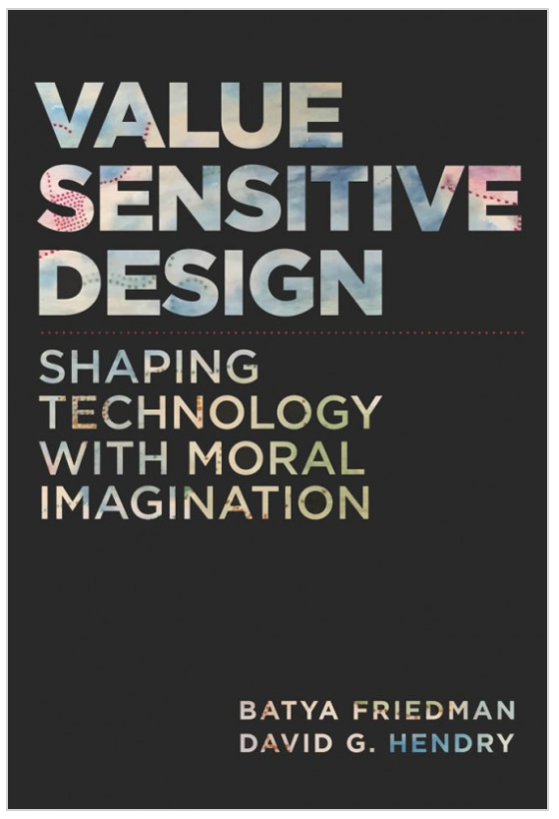
Unpacking “Public Interest”
What values might our software promote or diminish?
Human rights - Inalienable, fundamental rights to which all people are entitled
Accessibility - Making all people successful users of the technology
Justice - Procedural justice (process is fair) + distributive justice (outcomes are fair)
Privacy - An individual’s agency in determining what information about them is shared
Human welfare - Physical, material and psychological well-being
Value Sensitive Design @ Khoury
Notes:
Value-sensitive design is an approach to guide the design of technology while considering the impact of the technology on a variety of core human values. This approach can help us to identify unintended consequences of our software, which we can then begin to reason about.
Core values include human rights, accessibility, justice, privacy and human welfare, and many others.
As we think about the software that we’re building, we can ask ourselves explicitly: how does our software impact these values?

Slide 11
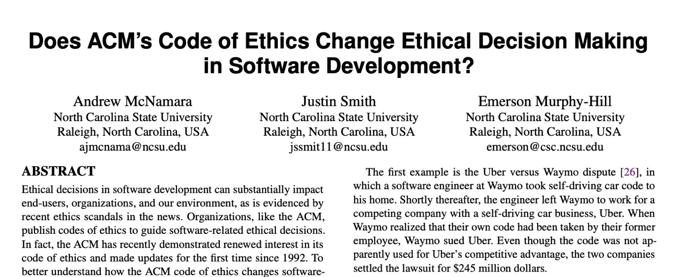
Code of Ethics
ACM’s Code of Ethics Software Engineers
TLDR: No
1. PUBLIC – Software engineers shall act consistently with the public interest.
2. CLIENT AND EMPLOYER – Software engineers shall act in a manner that is in the best interests of their client and employer consistent with the public interest.
3. PRODUCT – Software engineers shall ensure that their products and related modifications meet the highest professional standards possible.
4. JUDGMENT – Software engineers shall maintain integrity and independence in their professional judgment.
5. MANAGEMENT – Software engineering managers and leaders shall subscribe to and promote an ethical approach to the management of software development and maintenance.
6. PROFESSION – Software engineers shall advance the integrity and reputation of the profession consistent with the public interest.
7. COLLEAGUES – Software engineers shall be fair to and supportive of their colleagues.
8. SELF – Software engineers shall participate in lifelong learning regarding the practice of their profession and shall promote an ethical approach to the practice of the profession.
1. PUBLIC – Software engineers shall act consistently with the public interest.
https://ethics.acm.org/code-of-ethics/software-engineering-code/
Notes:
Studies have investigated whether simply exposing engineers to this code of ethics improves ethical decision making in software development
(Click)
(click),
concluding that this code alone does not improve ethical decision making.
Ethical decisions often involve weighing multiple trade-offs: in the case of the Citigroup tower, the engineering firm (and their client, and their insurer) had to make a difficult ethical choice: should they immediately publicly disclose the fact that a strong wind could topple the tower - clearly a concern in the public interest, or should they instead prepare with officials to perform an emergency evacuation and monitor the weather closely without informing the public about the potential hazard (which could provoke unnecessary panic)? A code of ethics alone does not give sufficient guidance.

Slide 12

Standards can give more concrete guidance.
International bodies define standard processes that are designed to protect the public
By (correctly) following such a standard, you can reduce the chance of harm to users, as well as your ethical (and legal) liability
Notes:
Areas where there are well-defined standards give the engineer more concrete guidance. For example, companies constructing medical device software must now comply with well-defined standard processes for developing that software in a way that will assure safety. Simply following the standard doesn’t guarantee safety, but doing so can help to ensure that it does, while also reducing our legal and moral liabilities.

Slide 13
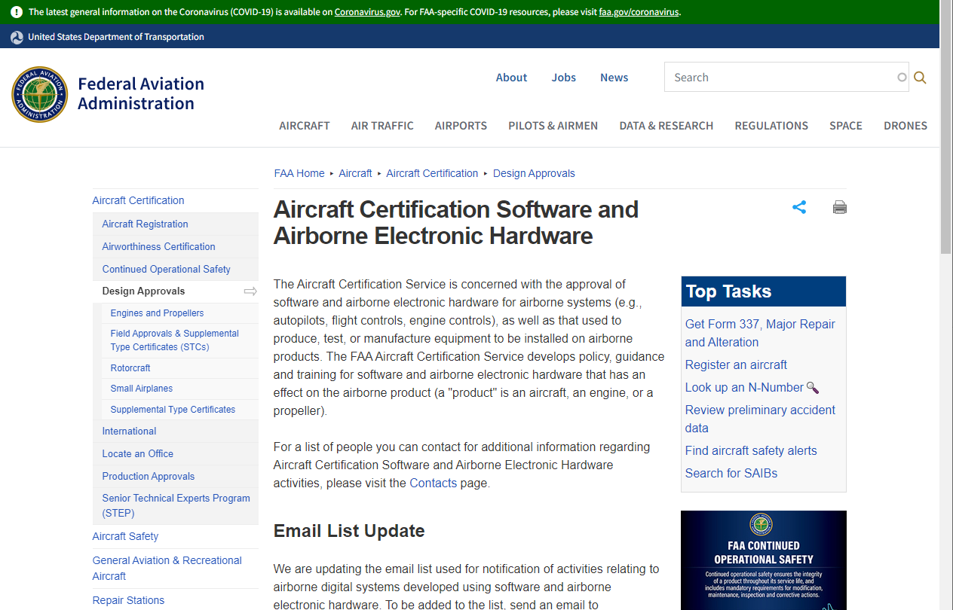
Standards can give more concrete guidance.
Notes:
Similarly, aircraft software must follow a rigorous certification process.

Slide 14
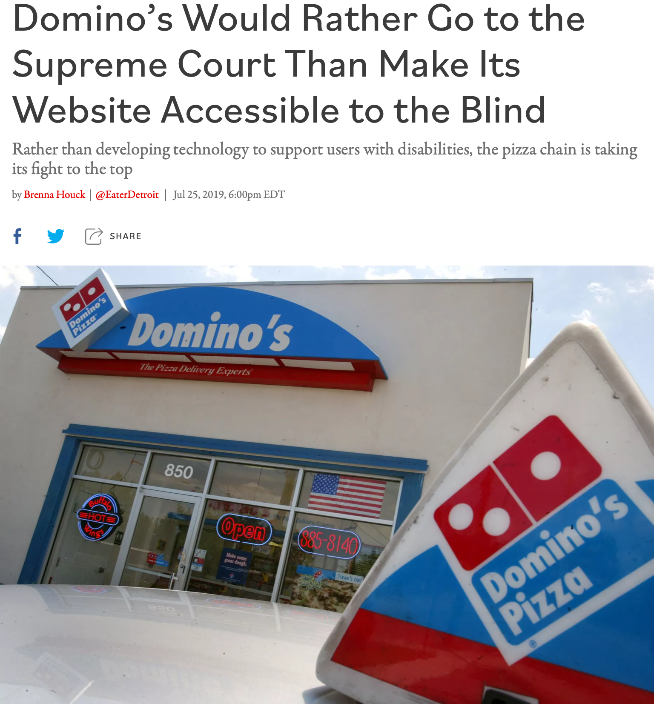
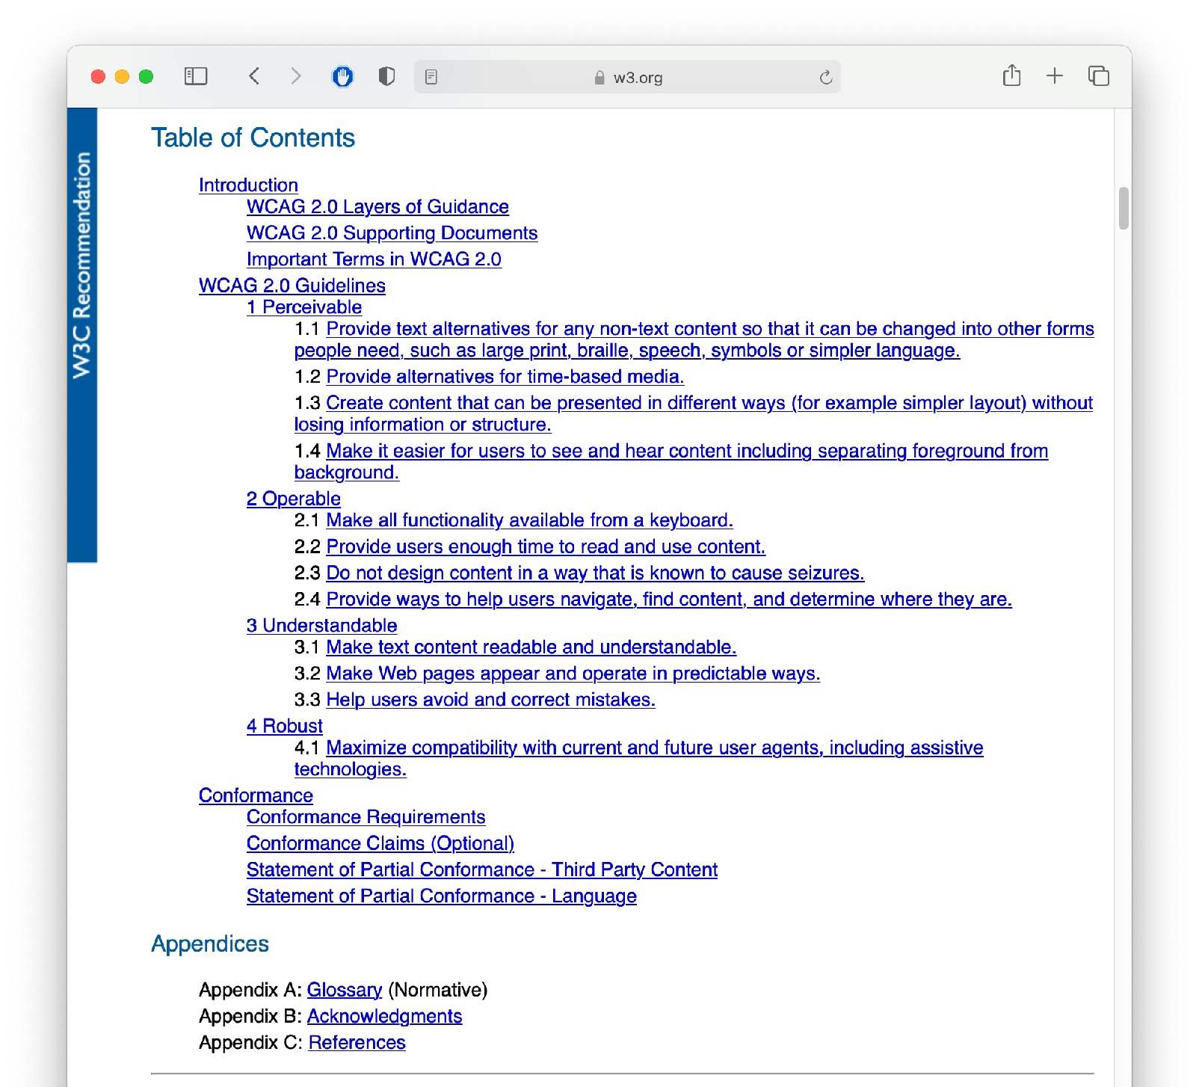
Standards can give more concrete guidance.
Example: Domino’s + ADA
WCAG 2.0 Spe
cification
Notes:
For example, in the case of Domino’s unwillingness to comply with the ADA, there was a standard that could have been followed: the Web Content Accessibility Guidelines (WCAG), which date from 2008– over a decade before the suit.
In court documents, Domino’s revealed it would have cost just $38,000 to resolve the raised accessibility issue

Slide 15
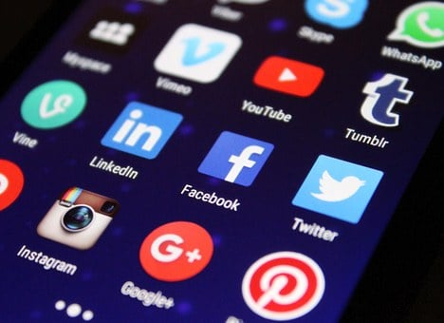
But many ethical decisions are still hard
Example: Social Media Platforms
Social media platforms like Facebook, Twitter, or Tiktok can
Build communities across distance
Spread information for social action
Spread misinformation and disinformation
Amplify hate speech
How to balance freedom vs regulation?

Slide 16
Where does this leave us?
So that we can sleep at night
Consider the different ways that our software may impact others
Consider the ways in which our software interacts with the political, social, and economic systems in which we and our users live
Follow best practices, and actively push to improve them
Encourage diversity in our development teams
Engage in honest conversations with our co-workers and supervisors to explore possible ethical issues and their implications.
Notes:
There’s no silver bullet for ethical software development. However, hopefully now you understand better the different ways that our software can have impacts on others, and how we can reason about those implications. The next and final lesson in this module will examine how we can better understand our users, so that we can make the best, most inclusive software, and in turn, hopefully cause the least unintended harm.

Slide 17
Learning Objectives for this Lesson
You should now be able to:
Explain several of the meanings of “the public interest”.
List some sources of ethical guidance for a software engineer.
List several things that a software engineer can do to try to behave in an ethical manner.

Slide 18
CS 4530 & CS 5500
Software Engineering
Lecture 12.3: Acceptance and Inclusivity Testing
© 2021, released under CC BY-SA

Slide 19
Learning Objectives for this Lesson
By the end of this lesson, you should be able to…
Explain ways in which developers of software often differ from the users of that software, introducing potential inclusivity bugs
Recognize persona-based cognitive walk-throughs as an approach to help put yourself in someone else’s shoes

Slide 20
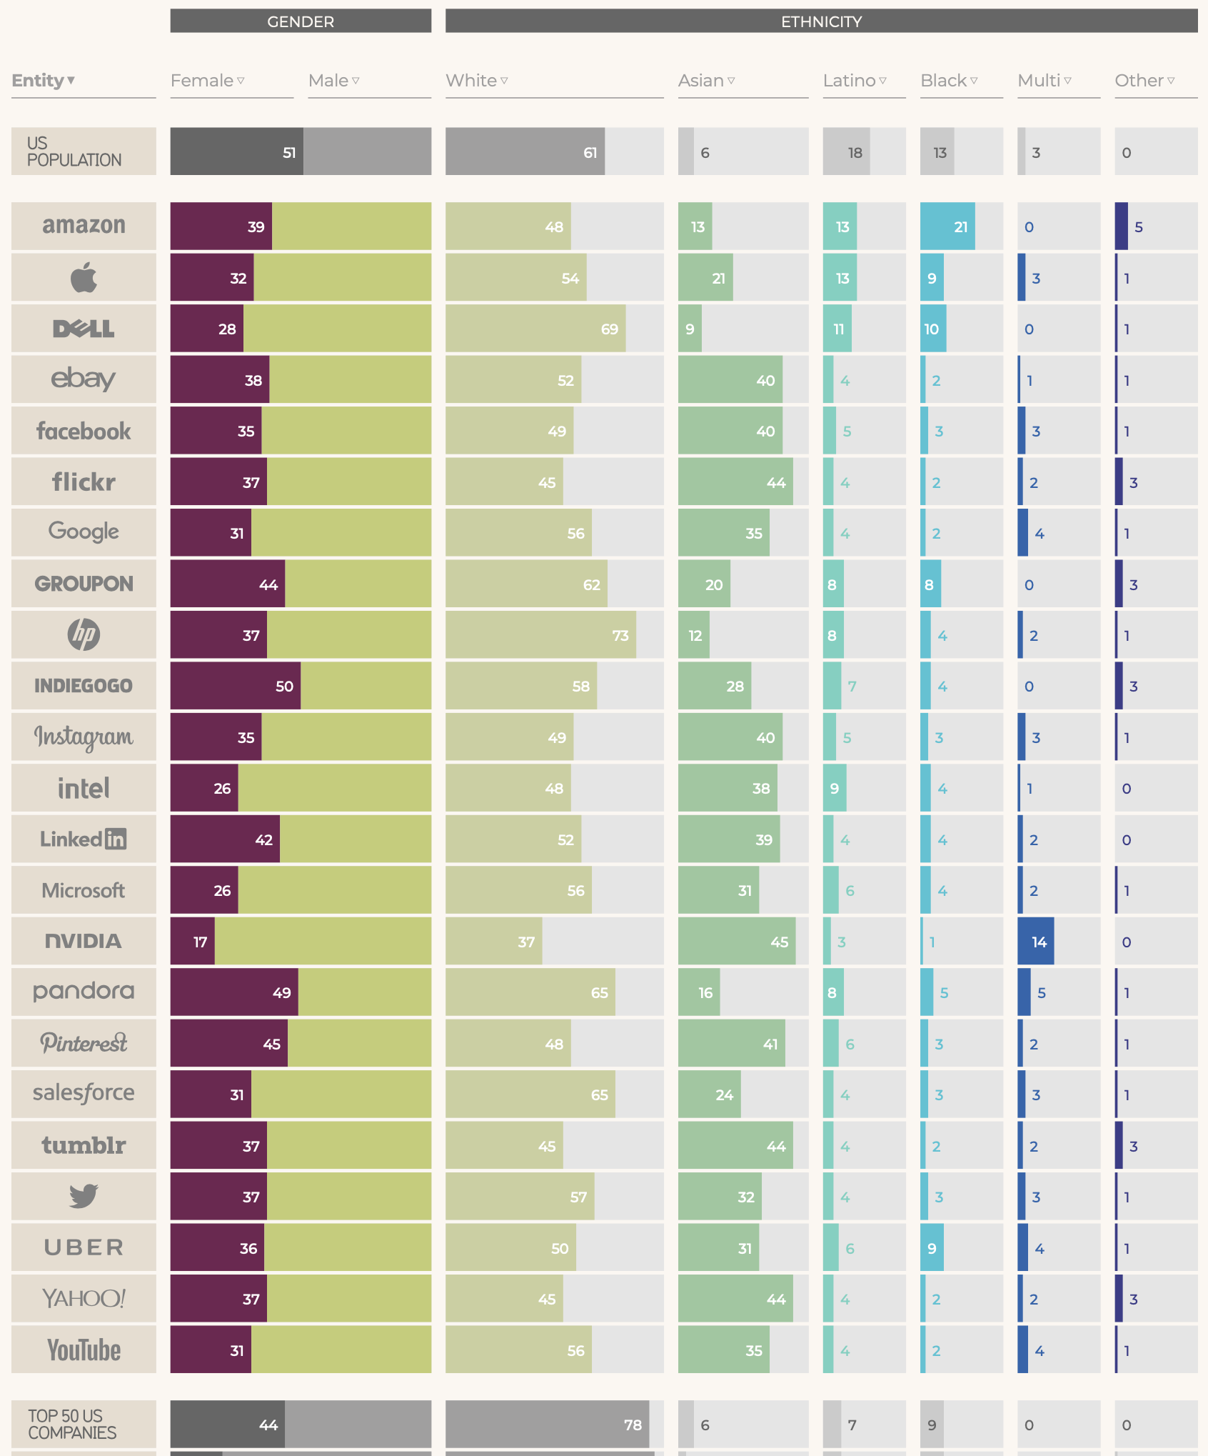
We are not our users
Data from 2017
Creating inclusive software requires us to acknowledge that we differ from our users
Our quality assurance is only as good as we can understand our users
https://informationisbeautiful.net/visualizations/diversity-in-tech/
Notes:
Our goal in this lesson is to explore approaches to detect equity and inclusivity bugs in software. How do we start? First, it is vital that we recognize that we each bring our own biases of how we expect our software to be used. Developers may differ from users in: nationality, ethnicity, race, gender, age, socioeconomic status, abilities, and belief systems. Creating inclusive software requires us to acknowledge these differences. Having diversity on your development team is one of the first steps towards creating inclusive software. However, attracting and retaining a diverse team is its own topic - this infographic shows the relative lack of diversity at top US-based tech firms, in comparison to the population of the US - teams often lack diversity in gender and ethnicity - and simplifying diversity to only gender and ethnicity can overlook other facets of how we vary. In this lesson, we’ll focus on approaches to better understand our users, and to evaluate whether our software is inclusive, usable, and accessible, or not.

Slide 21
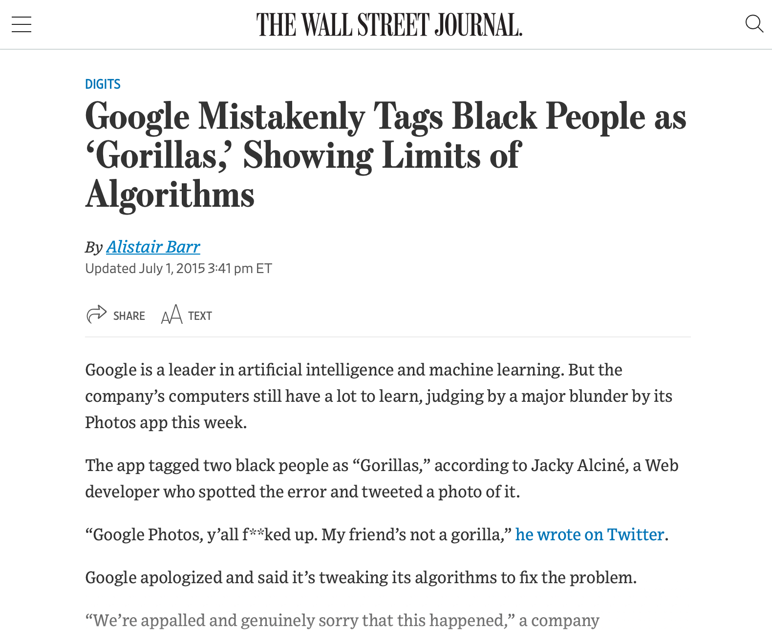
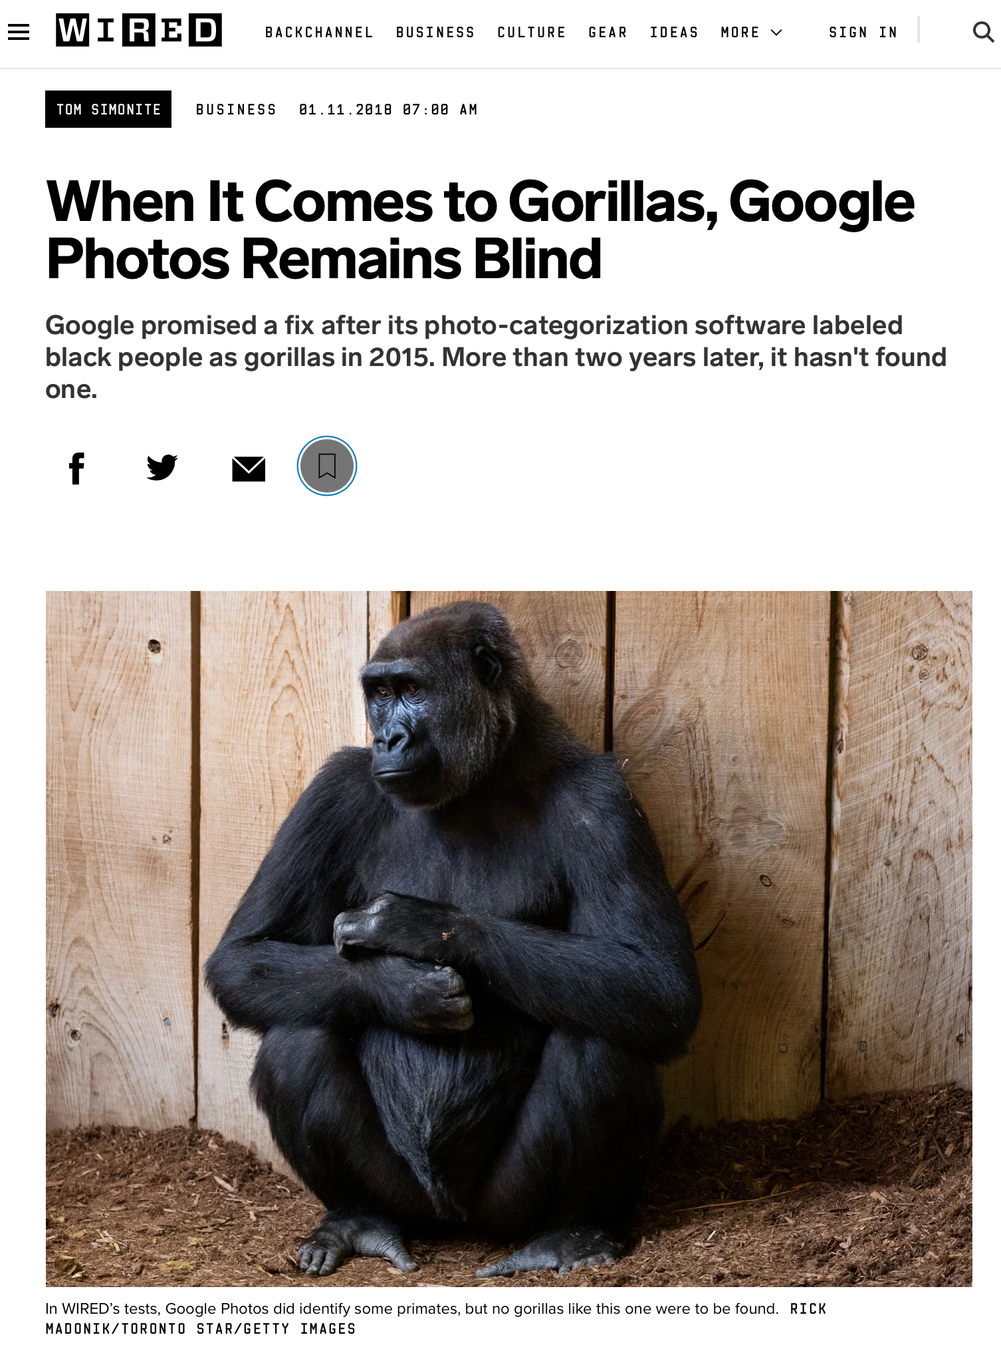
Bias is the Default
Example: Google Photos auto-tagging (2015)
https://www.wsj.com/articles/BL-DGB-42522
https://www.wired.com/story/when-it-comes-to-gorillas-google-photos-remains-blind/
Notes:
As a case example of bias as the default, consider this incident from 2015, when google released a new photo tagging feature in Google Photos, which was prone to misidentify black people in photographs as gorillas. How did this happen? Image recognition algorithm depend on being supplied a proper (complete) dataset - clearly an incomplete dataset, not representative of entire population. Why didn’t this come up in internal testing? To the extent that Google has a diverse development team today, that was much less true in 2015 - so nobody was trying it and finding this out, and the unconscious bias of the organization resulted in this product getting out. This was harmful both to users, and to Google’s reputation. Even today, this is not very well fixed - and is mostly side-stepped by not identifying any image as a gorilla. It’s useful to think of a case like this to set the tone for a conversation about diversity and inclusivity, but there are many more subtle biases in our software.

Slide 22

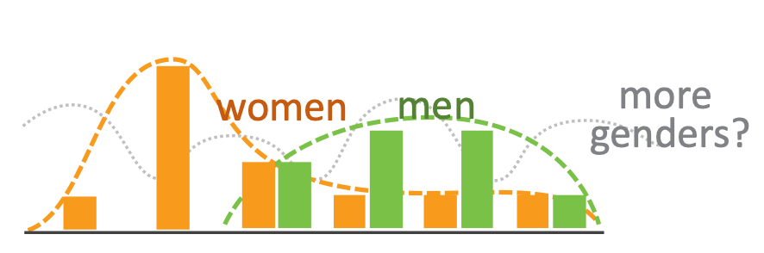
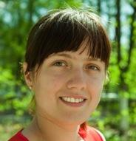
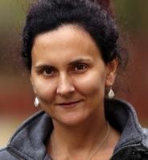
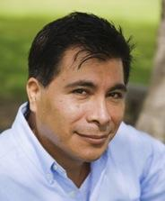
Unconscious Bias in Software
Does your software support a variety of users?
Aside from gender, race and ethnicity, how people interact with software varies, research has shown key inclusiveness facets:
Motivations
Information processing style
Computer self-efficacy
Risk averseness
Tech learning style
Idea: Perform cognitive walkthrough of our software, through the lens of someone else
Notes:
Aside from algorithmic biases, how does our unconscious bias translate into software that is not inclusive? Aside from gender, race and ethnicity, HOW people interact with software varies. Research has shown several key inclusiveness facets:
Motivations: do you learn new technologies in your free time, or only when you need to?
Information processing: do you gather all information comprehensively before trying to solve something, or do you prefer to gather information selectively as you go?
Computer self-efficacy: Do you feel confident about your ability to interact with a computer? If you struggle, do you blame yourself or the vendor?
Risk: will I make a mistake/spend more time than I have budgeted on this? If you try something that doesn’t work, does that change your attitudes towards that technology?
Tech learning style: do you favor process-oriented learning (go step-by-step) or tinkering?

Slide 23
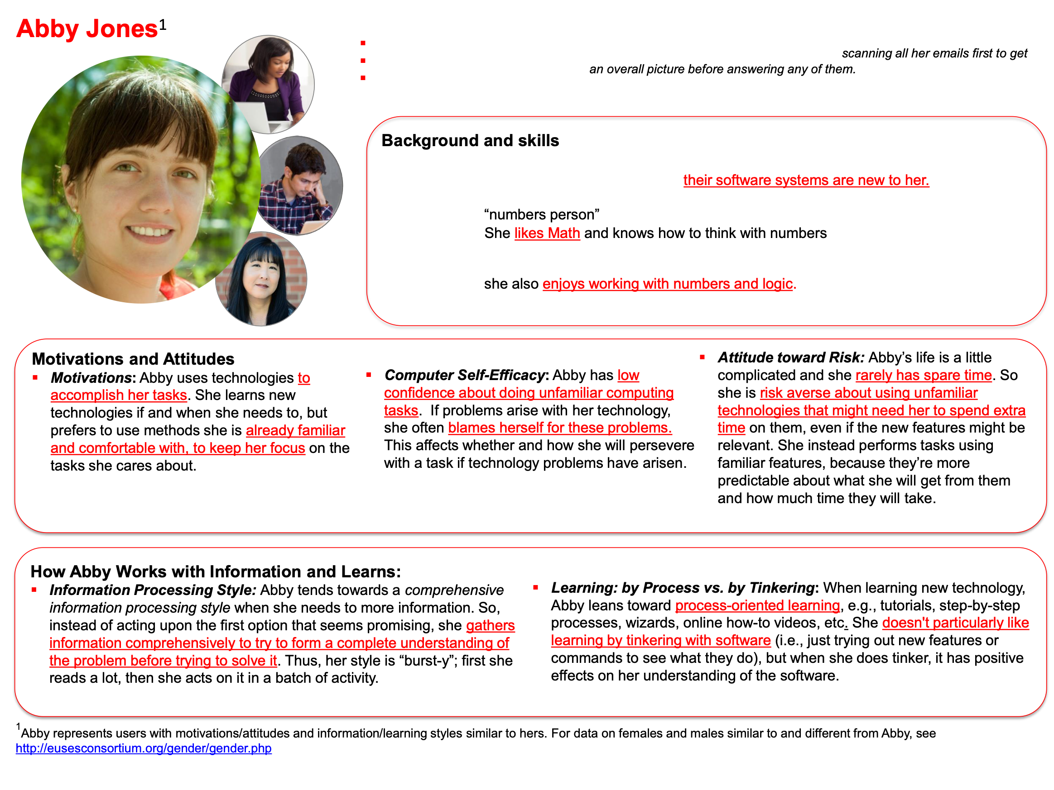
GenderMag: Gender Inclusiveness Magnifier
Persona-based evaluation
http://gendermag.org/foundations.php
Notes:
Persona-based evaluation allows for a “discount” usability evaluation. We don’t actually need to find real users who are different from us and get them to use our software (although that’s the best validation) - we can probably find lots of issues just by carefully walking through how someone like this persona would use our software (note: not actually persons that you know, not necessarily gendered)

Slide 24
GenderMag: Gender Inclusiveness Magnifier
Persona-based evaluation
Step through a use case for your tool, acting as the persona
Avoid jumping to conclusions - work in a group with multiple evaluators, take notes of issues as they occur
Compare to heuristic evaluation (week 6)
http://gendermag.org/Docs/GenderMagHandout-2020-0106-1649.pdf
Notes:
To perform a cognitive walkthrough, you and your team step through a single use case for your tool, acting as the persona.
For example: consider applying the Abby persona to evaluate an augmented reality application for navigating a book store…
Step by-step, note that “see map?” Is a difficult subgoal to form: abby’s motivation is to find science fiction books - why would they know that finding map is the right thing?
Then - note that “see bookstore map” is a “maybe” because Abby’s goal is “see map” but nothing says map! The developers meant ‘Browse off’ to mean to switch from a view where we are browsing a shelf to instead show the default, map view. If we’re not sure that Abby would know what to do [does abby tinker?], we note that, but then do it anyway.
Then, if we end up getting a map, we evaluate: does abby see progress to that subgoal of finding map? Maybe, maybe not - confusing. The facets of Abby’s persona allow us to imagine how another user, who doesn’t think like us, might interact with the same interface in a different way.

Slide 25
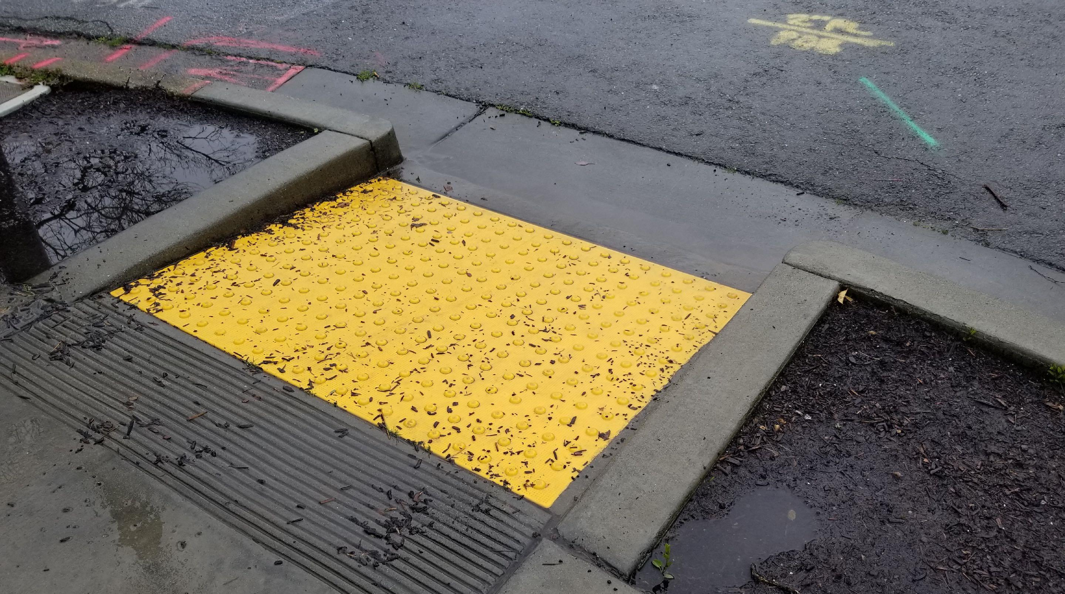
The Curb Cut Effect
“Curb Cuts” by Mike Gifford, CC BY-NC 2.0
Notes:
“The curb cut effect” describes broadly what happens when an inclusive design, built for one audience, benefits everyone. The effect gets its name from curb cuts - the small ramps between sidewalks and streets that were originally designed to allow people in wheelchairs to cross the street. However, this also benefits the old (who might struggle with a step), parents with strollers and workers making deliveries on hand trucks. For Example: Risk averse persona. Imagine that you are sloppy with vocabulary. “Browse off” vs “view map”. This is confusing. This is somethign that the risk averse individual might say “Wait what am I doing? I thought I was looking for a map. Oh I guess it’s turning off the browse feature?” This is like curb cuts though - it helps everyone, since, even if you weren’t particularly confused, it’s still a bit of a road bump.

Slide 26
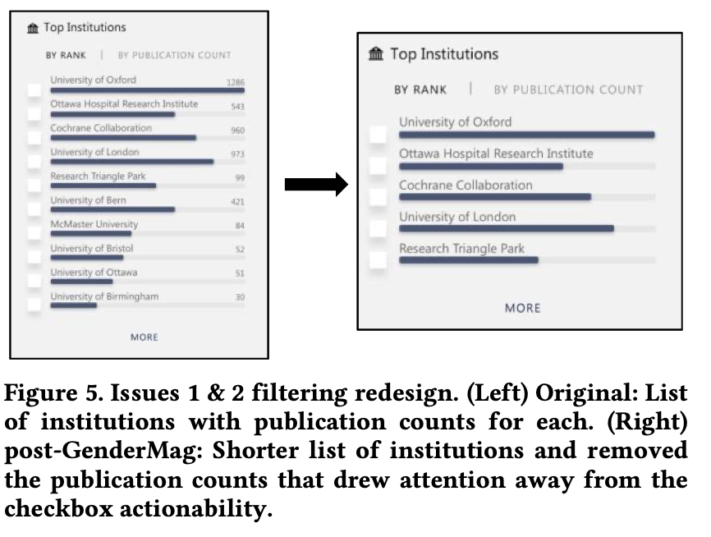
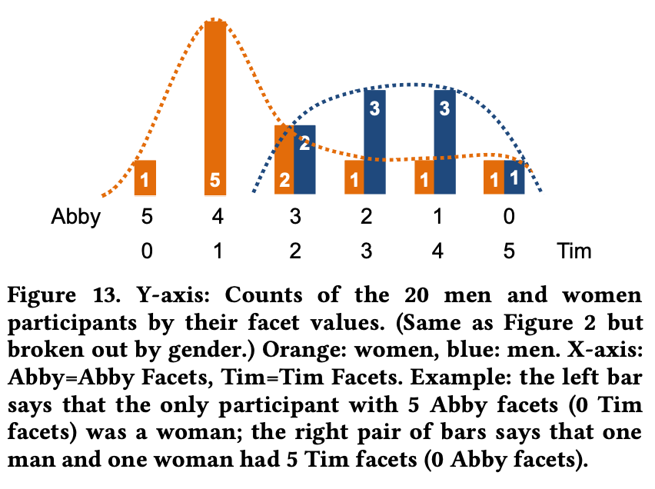
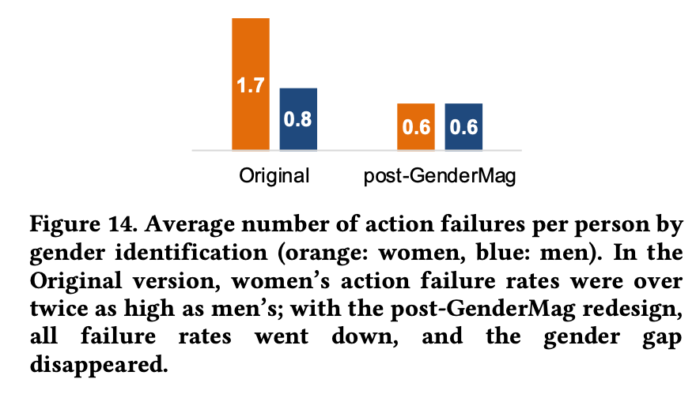
Usability Testing
Directly measuring the usability and inclusivity of our software
Observe real users interacting with your software - provide each user with a task, monitor their progress towards completing that task
Consider a diverse set of users that represent those who will use your software
Validate problems (and fixes) that you identify in cognitive walkthroughs
Example: applying GenderMag + usability testing for Microsoft Academic
ftp://ftp.cs.orst.edu/pub/burnett/chi19-GenderMag-findToFix.pdf
Notes:
The gold-standard for evaluating the efficacy of our software is usability testing.
Directly measure usability by monitoring task performance
Use diverse users, consider surveying based on facets - see figure in middle
Compare performance across interfaces (left figure, from MS academic prototype, can see it live)
Validate problems + fixes - and even find curb cut effect (Right figure)

Slide 27
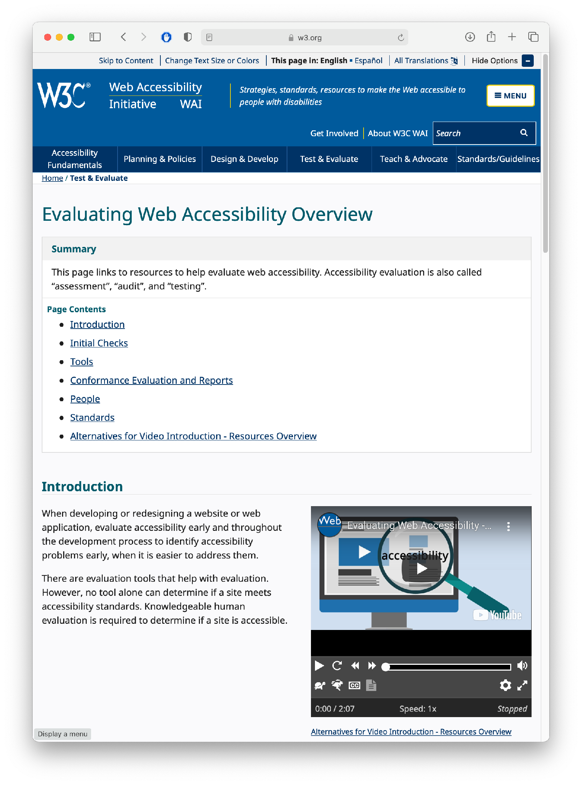
Usability Testing
Evaluating Accessibility
Check for conformance with requirements of standards
Involve users in your evaluation - simply “meeting a standard” does not guarantee accessibility
https://www.w3.org/WAI/test-evaluate/
Notes:
Evaluating accessibility is another form of usability testing. We can begin by checking (ourselves) the conformance of our application with the requirements laid out by standards, like the W3C’s WCAG (Web Content Accessibility Guidelines) standards. Simply meeting a standard doesn’t mean that it’s usable, and simply having one disabled person say that it works for them doesn’t mean that it’s usable - still conduct a broad user study for best results.

Slide 28
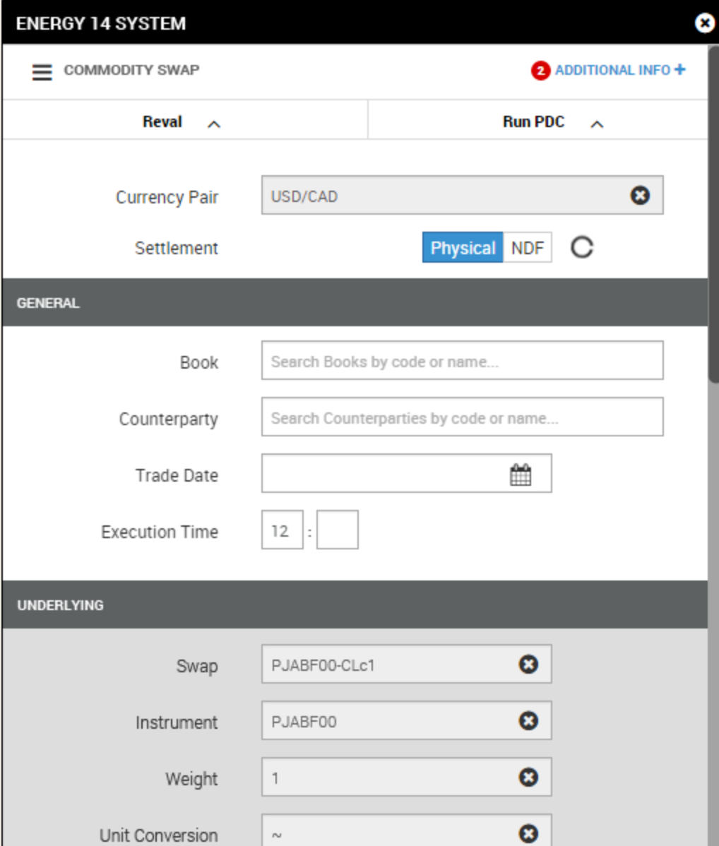
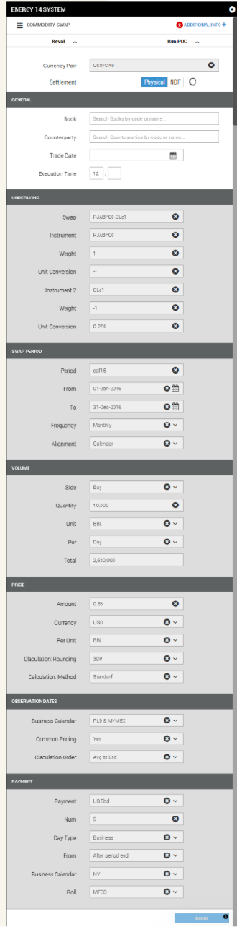
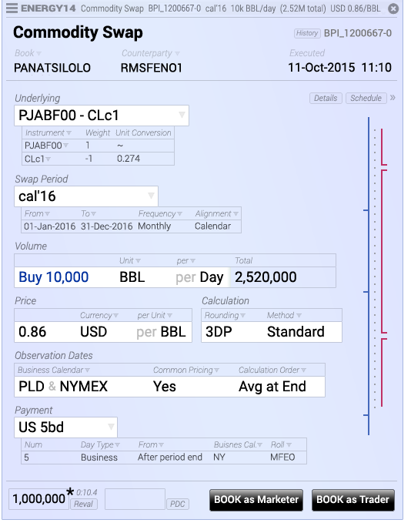
Usability Testing
For some software, we are nothing like our users
Commodity swap screens & story © 2016, Brad Paley
http://didi.co/consulting/
Notes:
User studies are extremely useful both when trying to build inclusive software that works for lots of users, and also extremely niche software that solves a specialized task. This is for energy commodities swap, a task that commodities traders might do many times an hour. Left interface seems “right” following Nielsen heuristics. But, the form needs to be filled out extremely fast - and it doesn’t even fit on a page! Right interface is the re-design, compresses data, meets users mental models. Better that you do this kind of testing before declaring your software “complete” so that you don’t lose a contract and get fired.

Slide 29
Usability Testing in Continuous Development
A/B Testing
Ways to test new features for usability, popularity, performance without a focus group
Show 50% of your site visitors version A, 50% version B, collect metrics on each, decide which is better
Notes:
In a continuous development environment, we can do live user studies with A/B testing…

Slide 30
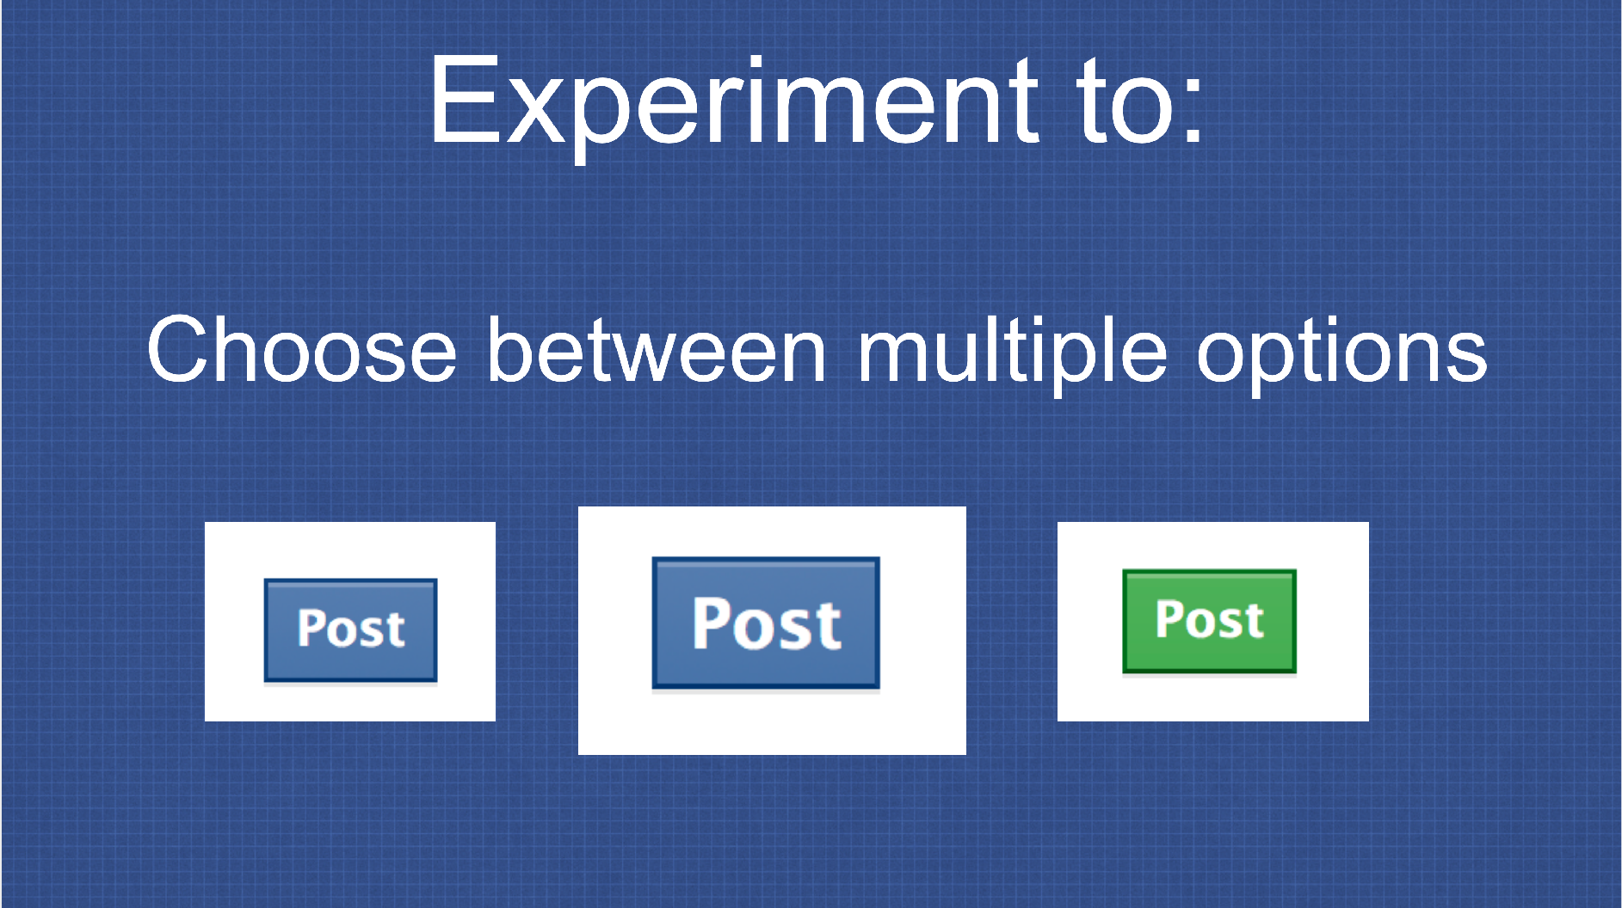
Usability Testing in Continuous Development
A/B Testing: PlanOut from Facebook (“N=10⁹ user study”)
Used to test advertising strategies (and Facebook functionality)
Segment audience and define KPIs, collect results
https://github.com/facebook/planout
https://www.slideshare.net/optimizely/opti-con-2014-automated-experimentation-at-scale
Notes:
Facebook performs these experiments constantly, and has even constructed an open source tool for doing so.
Basically doing a psychology experiment - try to avoid being evil (“show users sad posts, does that make them sad?”). Key feature: segment audience (think about diverse users) and collect results

Slide 31
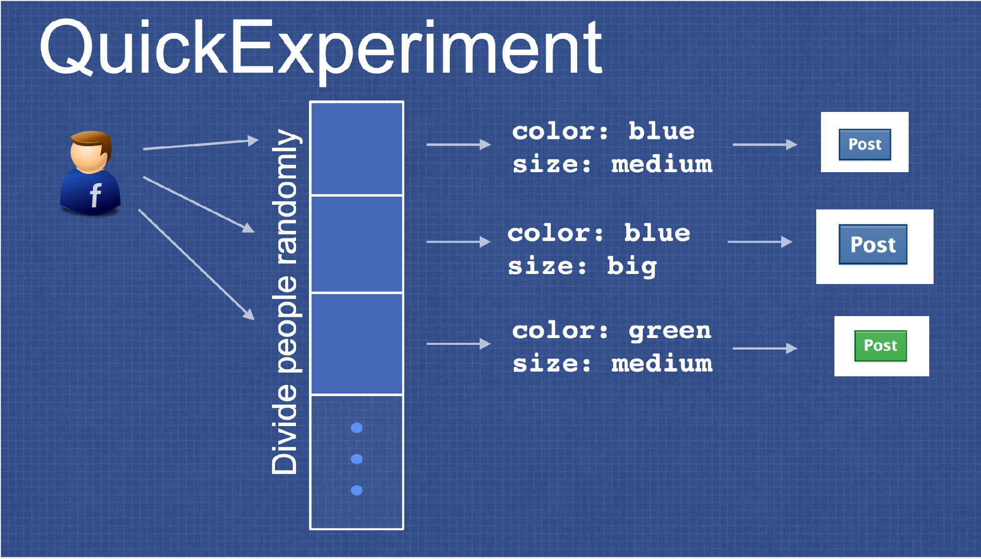
Usability Testing in Continuous Development
A/B Testing: PlanOut from Facebook (“N=10⁹ user study”)
https://github.com/facebook/planout
https://www.slideshare.net/optimizely/opti-con-2014-automated-experimentation-at-scale
Notes:
Example for a quick experiment - divide people randomly, show different post buttons

Slide 32
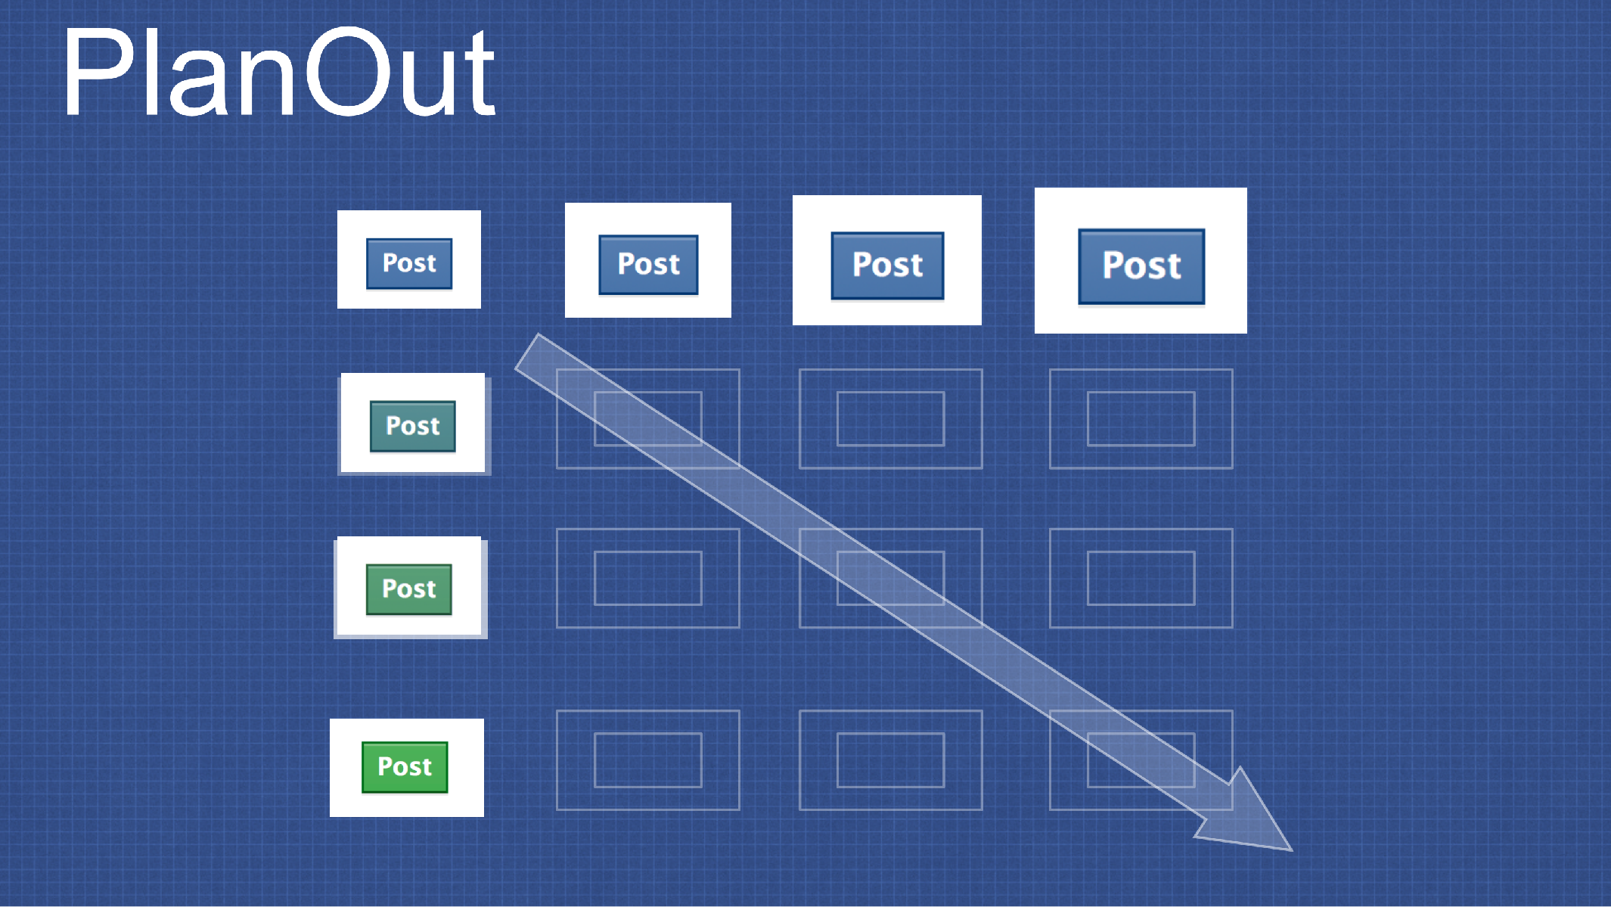
Usability Testing in Continuous Development
A/B Testing: PlanOut from Facebook (“N=10⁹ user study”)
https://github.com/facebook/planout
https://www.slideshare.net/optimizely/opti-con-2014-automated-experimentation-at-scale
Notes:
Can also consider gradients of options - say, controlling for size, and color

Slide 33
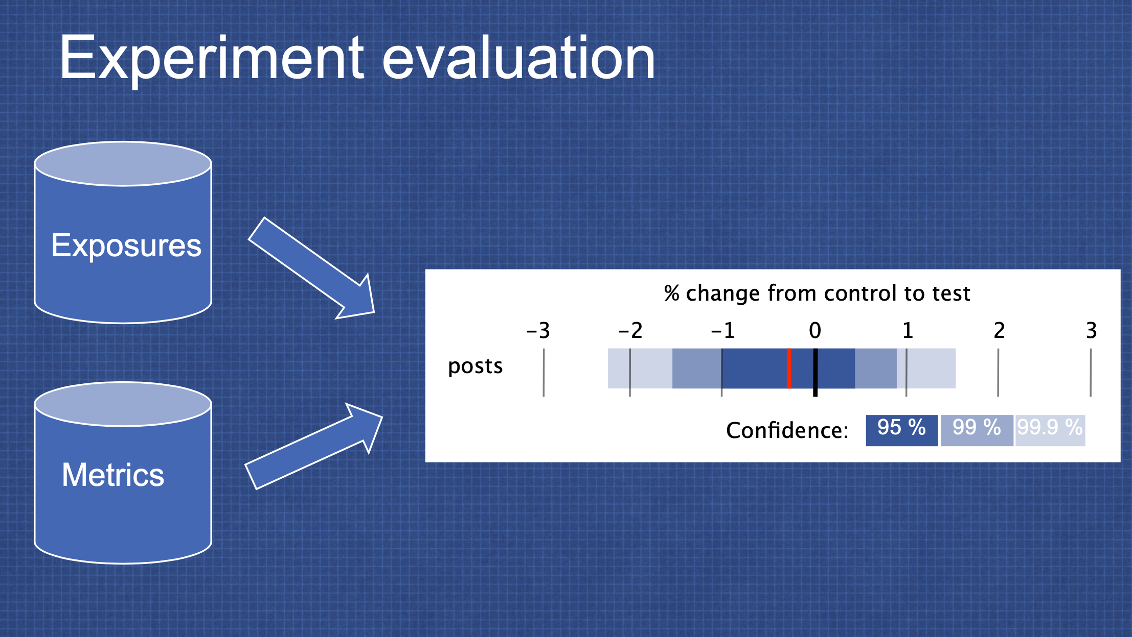
Usability Testing in Continuous Development
A/B Testing: PlanOut from Facebook (“N=10⁹ user study”)
https://github.com/facebook/planout
https://www.slideshare.net/optimizely/opti-con-2014-automated-experimentation-at-scale
Notes:
Then, take exposures + metrics, evaluate your KPI

Slide 34
Engineering Equitable Software
Key takeaways
With great power comes great responsibility
Anticipate the unanticipated consequences of your software
Limiting the accessibility of software might save money in the short term, but cost much more in the long term
Form a diverse development team, and involve a diverse group of users to validate your software
Notes:
There is an imbalance of power between those who write software and those who are subject to the implications of that software, sometimes at a disadvantage. As software engineers, it is vital that we anticipate the unanticipated - how might our software be inadvertently causing harm. Even if we are not building radiation therapy machines that can literally kill our users, we are still in a position of power to create software that is inclusive, and equally accessible to users who are not like us. Limiting the accessibility of our software (for instance, not adding support for screen readers, or not fixing the kinds of inclusivity bugs found by gendermag) might save money in the short term, but will likely end up costing much more in the long term. That you are taking this class, and still listening to this lecture likely means that you aspire to become an exceptional engineer - solve problems, and drive positive outcomes for a broad base of people. To do so, hopefully you are now aware of some strategies to consider how the software you build will be impact humanity, hopefully, for the better.

